Slide 1


NTT STOCK PRICE PREDICTION MODEL
EXPLORING ADVANCED DEEP LEARNING MODELS FOR FINANCIAL FORECASTING
財務予測のための高度なディープラーニングモデルの探求
Trainee Assignment
Shashank Shekhar Asthana
Department of Computer Science and Engineering, IIT Jodhpur

Slide 2


TABLE OF CONTENT
目次
00
Objective
01
04
Background
Evaluation Indicators
02
05
Data Analysis results
Verification results
03
06
Technology Overview
Summary

Slide 3


OBJECTIVE
The primary objective of this project is to develop a sophisticated predictive model tailored to the stock market, leveraging advanced machine learning technologies such as XGBoost, GRU, and neural networks. This model aims to enhance decision-making for investors, financial analysts, and portfolio managers by providing accurate, real-time stock price forecasts. By surpassing traditional forecasting methods, the project not only seeks to optimize investment strategies and risk management but also contributes to economic research by demonstrating the efficacy of cutting-edge algorithms in financial markets. Ultimately, this initiative will offer invaluable insights and tools to those engaged in Japan’s dynamic financial landscape, supporting more informed and strategic financial planning.
始めましょう

Slide 4

BACKGROUND
Importance of Prediction: Accurate stock price predictions are vital for risk management and investment strategy optimization in financial markets. In the world's third-largest economy, Japan, the stock market is an integral component of economic activity. Accurate predictions of stock prices are vital for both domestic and international investors who engage with entities like the Tokyo Stock Exchange.
Challenges in Stock Price Prediction: The main challenges include dealing with the inherent volatility of the stock markets, the influence of unforeseen global events, and the complex interactions between various economic indicators. Predicting stock prices in Japan presents unique challenges due to the distinct characteristics of its market, which include the influence of governmental policy changes, rapid technological advancements, and significant external trade impacts.

Slide 5
EXPLORATORY DATA ANALYSIS
The dataset for this project comprises detailed historical NTT stock price data from the Tokyo Stock Exchange, reflecting the trading activity over the past decade. It includes daily trading metrics such as opening prices, closing prices, highs, lows, and trading volumes for a selected range of stocks.
This data captures a broad spectrum of market behaviors and is instrumental in analyzing trends and patterns inherent in Japan's financial market.
Initial Data Exploration: We began the EDA by assessing the basic statistics of the dataset, including means, medians, ranges, and missing value counts. This helped us understand the general characteristics and the data quality.
Trend Analysis: We plotted time series graphs for various stocks to visually inspect trends, seasonal patterns, and volatility. This allowed us to identify cyclic behavior and potential anomalies in stock price movements.

Slide 6
EXPLORATORY DATA ANALYSIS
Volatility Analysis: We calculated the daily percentage changes for stocks, which helped us gauge the volatility and identify days with extreme fluctuations, which are crucial for risk assessment and predictive modeling.
Correlation Analysis: We examined the correlations between different stocks and between various trading metrics (like opening and closing prices). This helped in understanding the relationships within the data, which is vital for feature selection in predictive modeling.
Feature Engineering: Based on insights gained from the EDA, we engineered new features such as moving averages and lagged variables. These features are designed to capture temporal dependencies and trends that are not immediately apparent from raw data.
Trend Analysis: We plotted time series graphs for various stocks to visually inspect trends, seasonal patterns, and volatility. This allowed us to identify cyclic behavior and potential anomalies in stock price movements.
Given the range of values in trading volumes and prices, we applied normalization techniques to scale the features, aiding in more stable and faster convergence during the machine learning phase.

Slide 7
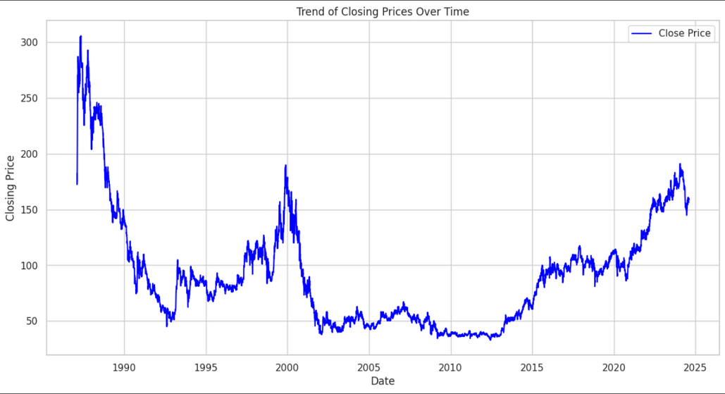
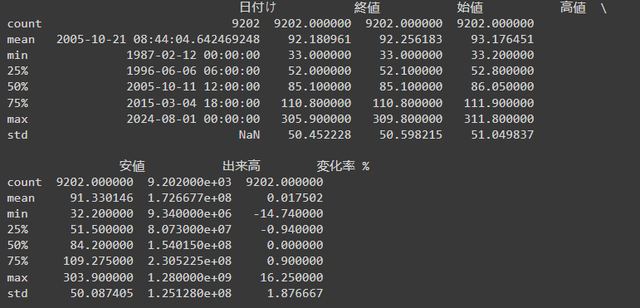
STATISTICS (統計)
Trends of closing price over time
Statistics of the dataset
The above graph represents the trend of closing price of each day over the time or date given
The above picture represents the statistics of the data while it contains the mean, min, standard deviation etc.

Slide 8
TECHNOLOGY OVERVIEW
MODELS EXPLORATION
01
ARIMA
03
GRU (Gated Recurrent Units)
ARIMA, an acronym for Autoregressive Integrated Moving Average, is a classic forecasting model used in time-series analysis to describe autocorrelations within the data.Leverages the relationship between an observation and a number of lagged observations.
Gated Recurrent Units are a simpler variant of LSTMs designed to adaptively capture dependencies of different time scales in a time-series data.These gates help the model determine how much of the past information needs to be passed along to the future, simplifying the structure and improving efficiency over LSTMs.
02
LSTM (Long Short Term Memory)
04
XGBOOST (eXtreme Gradient Boosting)
LSTM networks are a type of recurrent neural network (RNN) capable of learning order dependence in sequence prediction problems. Particularly useful in avoiding the long-term dependency problem, allowing it to perform better on tasks where context from much earlier is needed
XGBoost is an implementation of gradient boosted decision trees designed for speed and performance.Provides a highly scalable, efficient, and flexible solution to regression and classification problems, using both linear and tree-based learners.

Slide 9
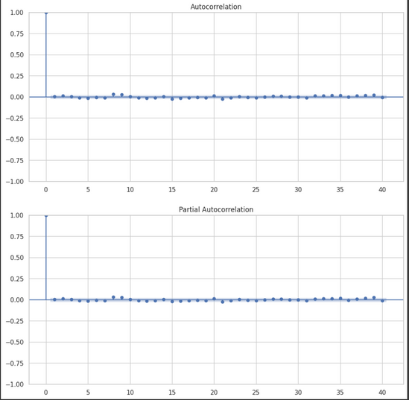
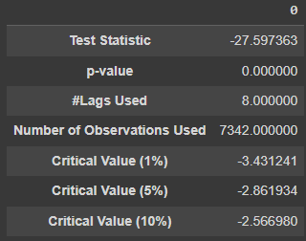
ARIMA
01
Model Configuration
自己回帰積分移動平均
We configured the ARIMA model with parameters p=1, d=0, and q=0, based on the preliminary analysis of the autocorrelation function (ACF) and partial autocorrelation function (PACF). This setup was chosen to model the data with a single lag value, reflecting a simple autoregressive nature of stock prices without needing differencing to achieve stationarity.
02
Stationarity Testing
Prior to modeling, we conducted an Augmented Dickey-Fuller (ADF) test to confirm the stationarity of the time series. The test results justified the use of d=0, indicating that the series did not require differencing to make it stationary, thus simplifying the model without sacrificing accuracy.
03
Performance Evaluation
After fitting the ARIMA model to the training data, we used it to forecast future stock prices and evaluated its performance using the Root Mean Square Error (RMSE). The RMSE provided a quantitative measure to assess how well the ARIMA model predicted the stock prices compared to the actual values in the test set. The RMSE Value comes out to be 80.444 .

Slide 10
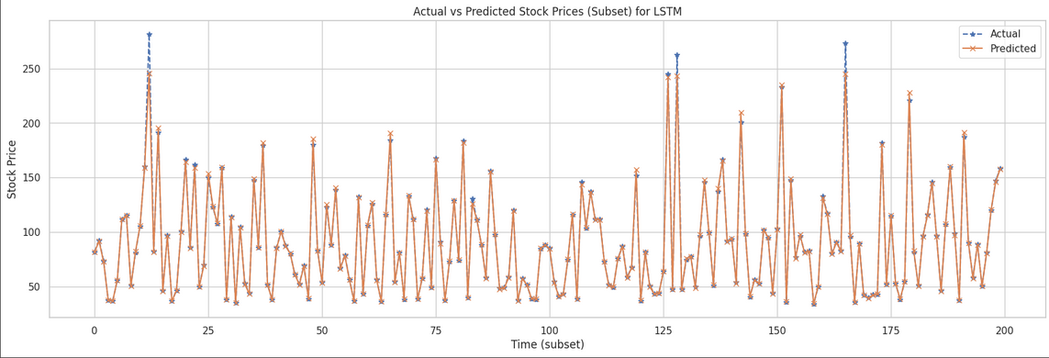
LSTM
01
Data Preparation
To accommodate the LSTM model, which requires input data in a specific format, we reshaped our time-series data into 3D format ([samples, time steps, features]). This restructuring was essential to enable the LSTM to effectively learn from the sequential nature of stock price data, capturing dependencies across time.
長期短期記憶
02
Model Architecture
We designed an LSTM network with multiple layers to deepen the learning capability. The model consisted of an LSTM layer followed by dropout layers to prevent overfitting. This setup aimed to enhance the model's ability to capture complex patterns in the stock price movements without memorizing noise.
03
Training and Evaluation
The model was trained on historical stock price data, using mean squared error as the loss function and Adam optimizer for efficient training. Post-training, the model's performance was evaluated on a separate test set, with RMSE used as the metric to quantify prediction accuracy. This evaluation helped confirm the model's effectiveness in forecasting stock prices. The RMSE value obtained is 4.33

Slide 11
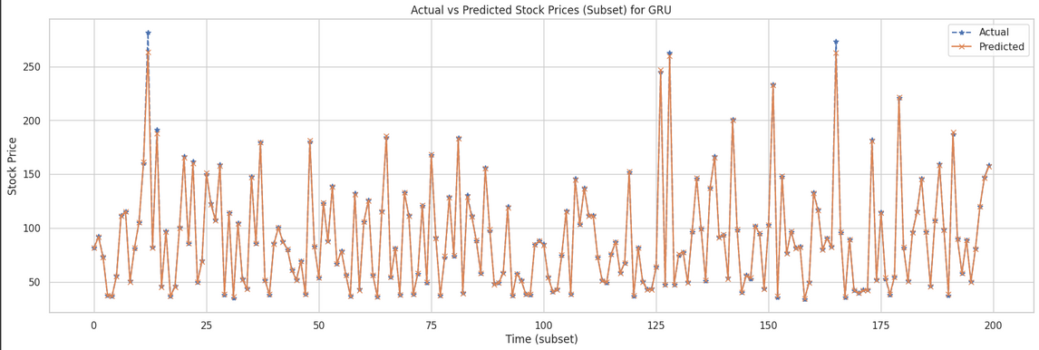
GRU
01
Model Setup
For the GRU model, we configured a neural network architecture using Gated Recurrent Units (GRUs) to optimize the learning process for sequential data. The GRU layers were designed to improve upon traditional RNNs by better managing the vanishing gradient problem, making them ideal for the long sequences found in stock price data.
ゲート付き再帰ユニット
02
Network Configuration
The network included multiple GRU layers with dropout layers interspersed to prevent overfitting. This configuration aimed to balance the model's complexity with the need to generalize well to new data, ensuring robust predictions even in the face of market volatility.
03
Training and Validation
The GRU model was trained on the preprocessed stock data, employing a batch size and epoch count optimized through preliminary testing. The performance of the model was rigorously evaluated using the RMSE metric on a designated test set, showcasing its predictive accuracy in comparison to other models like LSTM and ARIMA. While we got better results using GRU which was 2.186

Slide 12
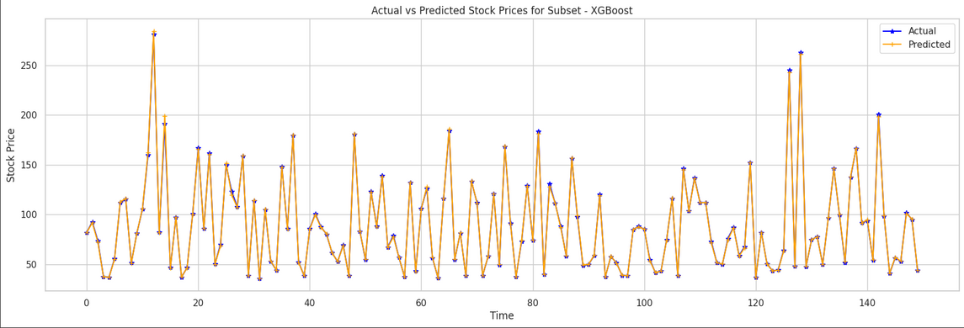
XGBOOST
01
Model Configuration
We utilized XGBoost, an advanced implementation of gradient boosted trees, known for its high efficiency and performance. The model was configured with specific parameters including a learning rate and number of estimators, tailored to optimize prediction accuracy for time-series data like stock prices.
極端な勾配ブースティング
02
Feature Importance and Selection
XGBoost's capability to provide insights into feature importance was leveraged to refine the input features, ensuring that only the most impactful variables were used. This step helped in enhancing the model's efficiency by focusing on features that significantly influence stock price movements.
03
Training and Performance Evaluation
The model was trained on a comprehensive dataset comprising historical stock prices and evaluated using the RMSE metric to assess its predictive accuracy. The low RMSE achieved indicated the model's superior ability to forecast future prices, outperforming other models tested in the project. While we got the most impressive results of RMSE value of 1.0617

Slide 13




EVALUATION INDICATORS
RMSE values obtained for top 3 metrics
XGBOOST
GRU
LSTM
RMSE value obtained when using XGBOOST regressor was of 1.0617, which is the best result obtained with predicted values matching actual
RMSE value obtained when using GRU was of 2.186, which is the second best result obtained with predicted values matching actual
RMSE value obtained when using GRU was of 4.67, which is the third best result obtained with predicted values matching actual
We can also use MAE (Mean absolute error) and MAPE (Mean Absolute Percentage Error) also for evaluation metrics, while both of them are giving the same results that XGBOOST performs the best.

Slide 14

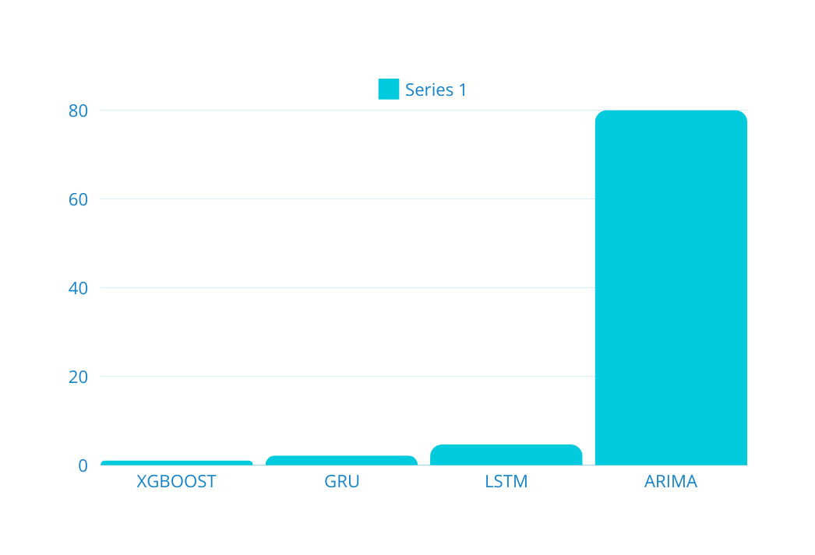
COMPARATIVE ANALYSIS ACROSS MODELS
The evaluation indicators revealed that the XGBoost model achieved the lowest RMSE, indicating superior predictive accuracy compared to ARIMA, LSTM, GRU, and other tested models. This comparative analysis was instrumental in selecting the most effective model for deployment in stock price forecasting.

Slide 15
SUMMARY
This project has successfully demonstrated the capability of advanced machine learning techniques, particularly XGBoost, to outperform traditional models in the stock price prediction arena.
Further insights were gleaned from an analysis of feature importance, which highlighted key drivers of stock price changes according to the model.
Detailed examination of the XGBoost model, which provided the best results with the lowest RMSE of 1.061, demonstrating its effectiveness in handling the nonlinear aspects of stock price movements.
Graphs comparing the actual and predicted values highlighted the accuracy of the XGBoost model, especially in capturing peak and trough patterns accurately

Slide 16
THANK YOU
ありがとう
Trainee Assignment
Shashank Shekhar Asthana
Department of Computer Science and Engineering, IIT Jodhpur

